Slide 1
People in Detention with Vulnerabilities

Slide 2
What will we cover?
Adults at Risk
Rule 35
National Referral Mechanism
Evidencing Vulnerability
IRC Response
Notes:
It was born out of the Government's obligation to identify victims under the Council of Europe Convention on Action against Human Trafficking, which came into force on 1 February 2008.

Slide 3
Who is an ‘Adult at Risk’?
Individuals will be regarded as ‘adults at risk’ if they declare or there is evidence that they:
Are suffering from a condition, or have experienced a traumatic event that would be likely to render them particularly vulnerable to harm if they are placed in detention or remain in detention.
Have professional evidence indicating the above whether or not the individual has highlighted this themselves
Observations from members of staff lead to a belief that the person
is at risk, in the absence of a self-declaration or other evidence
https://assets.publishing.service.gov.uk/government/uploads/system/uploads/attachment_data/file/1152054/Adults_at_risk_in_immigration_detention_GOV.pdf
Notes:
The ‘Adults at Risk’ Home office guidance came into effect in 2016. It recognises that vulnerable individuals (‘adults at risk’) may be at increased risk of harm from detention and states that such individuals should not normally be detained and can only be detained when ‘immigration factors’ outweigh their indicators of risk.
Traumatic event - (e.g. trafficking, torture, sexual violence)

Slide 4
Home Office indicators of risk
Serious physical disability
Serious physical health conditions or illnesses
Mental health conditions
Torture victims
Potential victims of trafficking or modern slavery
Pregnancy
Being aged 70 or over
Being a transgender or intersex person.
Other conditions

Slide 5
Adults at Risk
In all cases in which an individual is being considered for immigration detention in order to facilitate their removal, an assessment must first be made by the ‘detention gatekeeper’ of whether the individual is an ‘adult at risk’ in the terms of this policy.
As part of the induction process into immigration removal centres (IRCs) all individuals should have a medical screening within 2 hours of their arrival and must be given an appointment with a GP within 24 hours of admission to an IRC. This is under Rule 34 which functions to identify the immediate health needs of a detained person.

Slide 6
Rule 35
Rule 35 is a mechanism which aims to ensure that particularly vulnerable detained people (‘adults at risk’) are brought to the attention of those with direct responsibility for maintaining and reviewing their detention.
Rule 35 requires a report to be written by the GP working inside Immigration Removal Centres under three circumstances.

Slide 7
Rule 35 (1)
Rule 35 (2)
Rule 35 (3)
If a detained person’s health is likely to be injuriously affected by continued detention or any conditions of detention
If a detained person is suspected of having suicidal intentions
If there are concerns that the detained person may have been the victim of torture
Notes:
The person in detention has to request a Rule 35 from Healthcare – occasionally Healthcare may raise the Rule 35 in response to something the person says. Then an appointment is made with the GP. During the appointment the GP fills out a Rule 35 (1), (2) or (3) form and then sends it to the Home Office Rule 35 team.

Slide 8
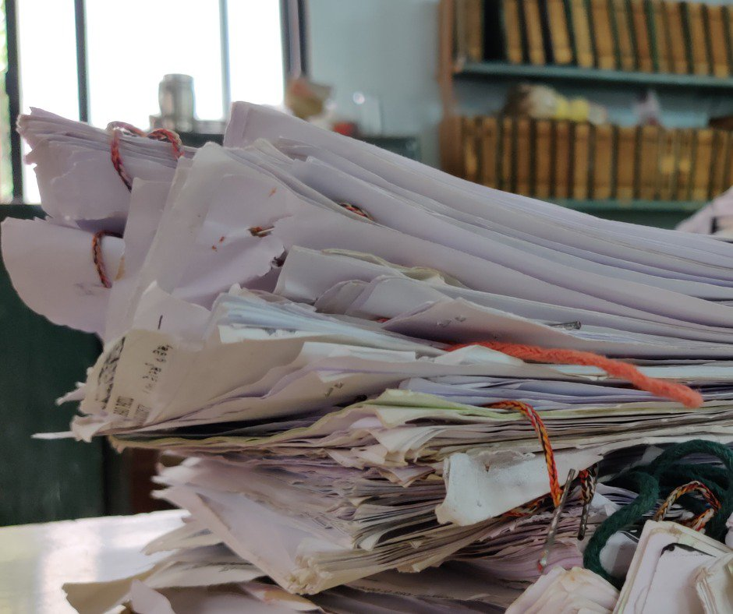
Rule 35
After a GP undertakes a Rule 35 report it is sent to the Home Office to review and consider the Adults at Risk policy to classify which level of vulnerability a detained person is at.
Responsible Home Office officers have two working days after accepting receipt to provide a response to the rule 35 report.

Slide 9
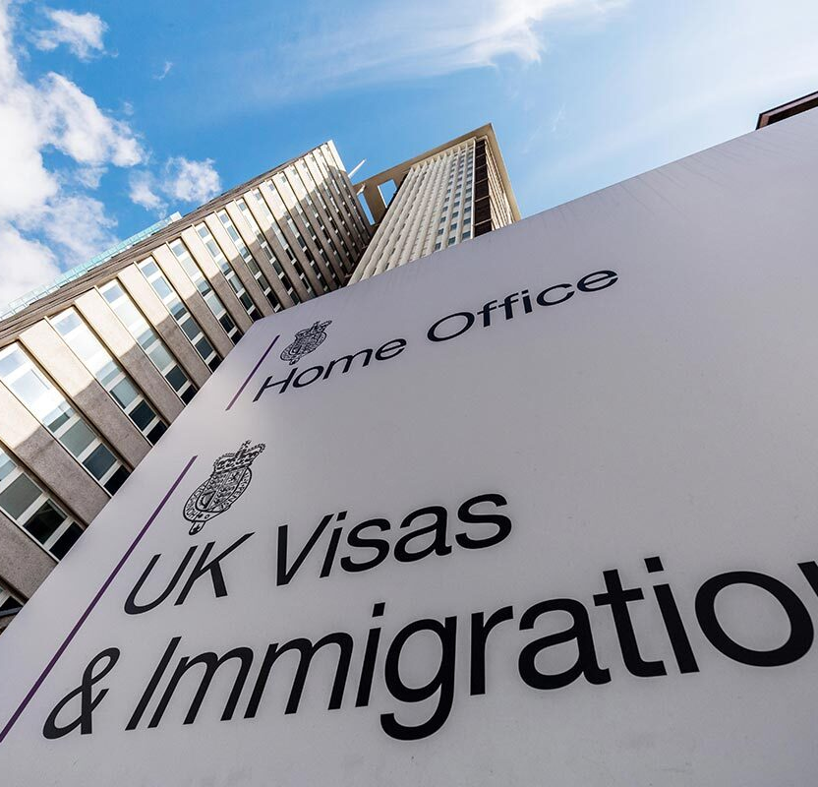
Vulnerability Levels
In the Home Office response the evidence of vulnerability is classified in three levels:
Level 1 - self-reporting
Level 2 - professional evidence of a category of vulnerability
Level 3 - bespoke professional evidence that a period of detention is likely to cause harm.
This category of vulnerability and evidence level is balanced against immigration and public protection factors in deciding whether someone should be detained.

Slide 10
Issues with Rule 35’s
The Brook House Inquiry found that the Rule 34 and Rule 35 processes are not being used effectively.
Even when vulnerabilities (such as suicidality, mental health concerns, torture) were identified, this did not always lead to a Rule 35 assessment or report.
https://brookhouseinquiry.org.uk/main-page/volume-2-level-1/part-e-recommendations-to-prevent-recurrence-of-mistreatment/safeguards-for-vulnerable-individuals/

Slide 11
Issues with Rule 35: 1 and 2 rarely used
In 2022 –
Rule 35(1) - Health Concerns – Only 29 reports made across all IRC’s. Only 13 were made in Brook House and 0 in Tinsley House.
Rule 35 (2) - Suicide Risk - Only 25 reports made across all IRC’s. Only 9 were made in Brook House and 0 in Tinsley House.
Rule 35 (3) - Torture Allegation – A total of 1347 made across all IRC’s. A total of 327 were made in Brook House and 1 in Tinsley House.
https://www.gov.uk/government/publications/immigration-enforcement-data-q4-2022

Slide 12
Other Issues with Rule 35
Delays to getting Rule 35 appointments
Poor quality reports
Delays in the Home Office response to reports
https://www.gov.uk/government/publications/immigration-enforcement-data-q4-2022
Notes:
Current wait times for Rule 35 in Brook House IRC – 2 weeks

Slide 13
Modern Slavery
Modern slavery may involve multiple forms of exploitation. It encompasses:
Human trafficking
Slavery, servitude, and forced or compulsory labour
An individual could have been a victim of human trafficking and/or slavery, servitude and forced or compulsory labour.
Notes:
Victims may not be aware that they are being trafficked or exploited, and may have consented to elements of their exploitation, or accepted their situation. If you think that modern slavery has taken place, the case should be referred to the NRM so that the relevant competent authority can fully consider the case. You do not need to be certain that someone is a victim.

Slide 14
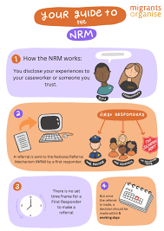
National Referral Mechanism
The National Referral Mechanism (NRM) is a framework for identifying victims of human trafficking or modern slavery and ensuring they receive appropriate support.
Notes:
It was born out of the Government's obligation to identify victims under the Council of Europe Convention on Action against Human Trafficking, which came into force on 1 February 2008.

Slide 15
NRM Process
A potential ‘victim’ is referred into the NRM
This referral has to be made by a first responder: the police, certain charities, Home Office, Local Authorities, Police, National Crime Agency, Gangmasters and Labour Abuse Authority.
An interview takes place.
Reasonable grounds decision
After the interview, a decision is made within 5 days. Threshold low: ‘I suspect but cannot prove’. Positive decision triggers a 45-day recovery and reflection period – removal not possible, support available.
Conclusive grounds decision
Threshold for this is: ‘It is more likely than not’. The burden of proof is more stringent than the reasonable grounds decision.
Notes:
Support = financial help £25 per week, support worker and safe houses

Slide 16
Public Order Disqualifications
On 7 March 2023, the UK Government introduced the Illegal Migration Bill with the stated purpose to “prevent and deter unlawful migration, and in particular migration by unsafe and illegal routes.”
This Bill made it possible to disqualify individuals from the NRM process due to their criminal history.
POD’s have been given to people months after they received a positive reasonable grounds decision on the NRM.
POD’s have been given to people who went to prison due to being a victim of modern slavery.
Notes:
If a person you are supporting has a criminal background and is referred into the NRM, please let them know this is a possibility and advise them to discuss with their solicitor/ask their solicitor to raise the reasons why it shouldn’t be disqualified.

Slide 17
Evidence to show vulnerability
Medico-legal reports: In a Medico-Legal Report an independent doctor documents the psychological and/or physical result of trauma and/or health issues.
Organisations that support with this:
Medical Justice, Forrest Medico-Legal, Freedom from Torture, Helen Bamber Foundation
Notes:
Medico-Legal Reports (MLRs) are written by qualified clinical experts and are commissioned by a legal representative who provides detailed instructions. Covered by legal aid. Independent clinicians can also be instructed.

Slide 18
IRC Response
Daily Operations Meetings
Weekly Vulnerable Residents Meeting
Monthly Safer Community Meetings
Supported Living Care Plans
Assessment care in detention and teamwork (ACDT)
Notes:
Daily Operations Meeting: Meeting with Contract Director, Senior Management Team, Operational Managers. Review of last 24 hours. People with vulnerabilities discussed.
Weekly Vulnerable Residents Meeting: ACDT’s, Adults at Risk Level 3, Unfit to fly/unfit to detain, Supported living facility/medical isolation, Room sharing risk assessment/single occupancy (everyone should have one on arrival and should be reviewed every 3 months), complex physical and mental health issues, Welfare issues. Attendees: HO, H/C manager, Security manger, Residential manager, Welfare Services, IMB
Monthly Safer community meetings: Lead by the Serco Safeguarding Director, reports on stats and issues in the IRC – e.g. how many people on ACDT/hunger strike/incidents of self harm etc

Slide 19
Assessment care in detention and teamwork (ACDT)
The ACDT process is used to manage detained people who are identified to be at risk of suicide or self-harm. However, not all people under ACDT are considered an AaR.
An ACDT can be opened by any IRC staff member who receives information or observes behaviour which may indicate an individual may currently be at risk of self-harm or suicide.
Written observations
Reviews every 24 hours
Constant supervision
Regular checks
Removal of items to mitigate risk of self-harm
Use of Rule 40
Notes:
Within an hour of a concern form being completed, the duty operations/residential manager must:
meet with the detained individual, (unless they are asleep) to check on their wellbeing and complete the immediate action plan to ensure the detained individual is safe from harm. This includes consideration of any interventions to mitigate the risk of self-harm, such as the individual’s location or removal of items from their possession
Closing an ACDT: The ACDT plan can only be closed once the risk of harm has been reduced to a level where it is no longer considered raised and all the care plan actions have been completed with their intended outcomes. The decision to close an ACDT must be taken by the case review team and explained to the individual
Use of Rule 40: for the shortest possible time and as a last resort after all other alternatives have been considered

Slide 20
Questions?

