Slide 1
Accommodation options
Disclaimer: Generally this is based on single men, in detention.

Slide 2
Types of home office accommodation
Hotel Accommodation – S.98
Shared Accommodation – S95, S4, S10
Private/not shared – Those with dependents, evidenced health needs, perhaps with probation limits.
To access Home Office accommodation/support you must prove you are destitute.
Destitute = not enough money, or support from friends or family to support themselves with accommodation and essentials for 14 days.
Notes:
Generally determined by immigration status and destitution.
Hotel Accommodation – S.98
Shared Accommodation – S95, S4, S10
Private/not shared – Those with dependents, evidenced health needs, perhaps with probation limits.
Destitute = not enough money, or support from friends or family to support themselves with accommodation and essentials for 14 days. HO considers this to be (£47.39 x 2) + the cost of hotel/hostel accommodation for 14 days.
Can be anywhere in the UK – no choice.

Slide 3
Section 95
Section 4
Ongoing asylum claim;
ASPEN card to cover food, essentials, and withdraw cash;
Often shared living with communal areas and access to a kitchens.
Refused asylum claim or appeals exhausted;
ASPEN card to cover food and essentials, but cannot withdraw cash;
Often shared living with communal areas and access to a kitchens.
Notes:
95
Shared Home Office accommodation for people who have claimed asylum and are waiting for a decision. Person must prove they are destitute to qualify.
Can be accommodation and financial support, or one or the other.
Person is given an ASPEN card with £47.39 a week, and can withdraw cash. Accommodation is not catered, so they will have to buy and prepare food.
4:
Shared Home Office accommodation for people who have received a negative decision on their asylum claim, or who are putting in further submissions to a refused decision.
Person has to have both accommodation and financial support. They are given an ASPEN card with £47.39 a week but are not allowed to withdraw cash.
Accommodation is self-catered, so they will have to buy and prepare their own food.

Slide 4
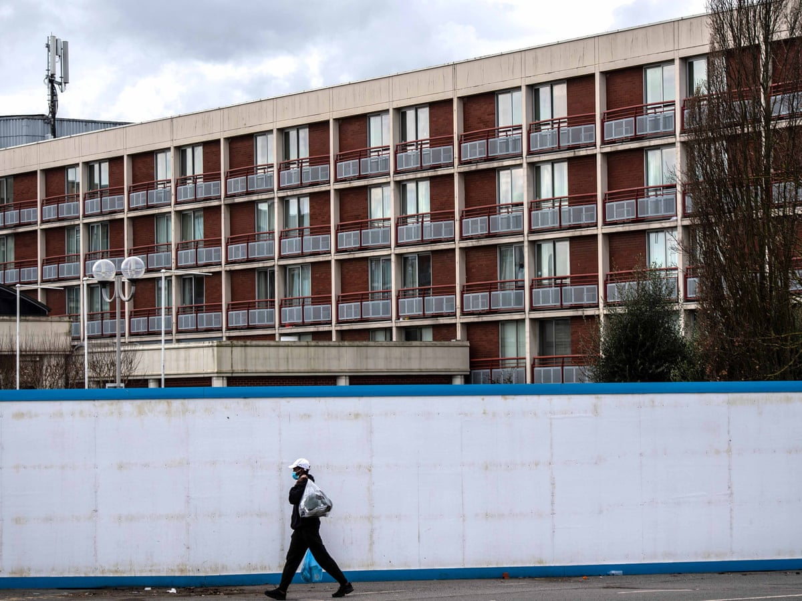
Section 98
Asylum accommodation but on an emergency basis. Should be temporary.
Usually hotel accommodation –meaning meals included.
ASPEN Card given with 9.58 a week to cover travel or other essentials.
Notes:
Emergency and temporary Home Office accommodation for people who are in the asylum process. The person must be homeless or about to be homeless to qualify.
Generally, hotel accommodation, the person receives £9.58 a week as their meals are included.
NB: generally these are not accepted while a person is in detention

Slide 5
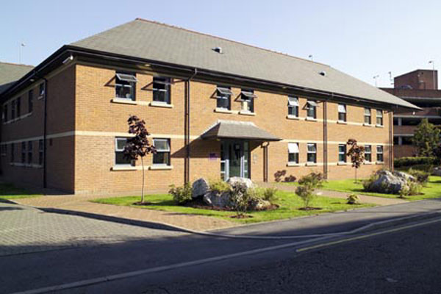
Schedule 10
Shared accommodation for those who cannot leave the UK due to immigration factors (i.e would like to return but can’t, or have other immigration cases)
Must be destitute.
Approximately £47.39 a week to cover food, travel and other expenses.
Access to communal areas and kitchen spaces.
Notes:
Shared, self-catered Home Office accommodation for people who are not in the asylum process but cannot leave the UK and are entitled to Home Office accommodation (if destitute).
This could mean:
People who have a Human Rights claim – not asylum claim – that is still pending;
People who have pending convictions and cannot leave the UK until they are resolved;
People who are voluntarily returning, but the delays to travel documents, flights etc. are such that they must wait for their flight to be confirmed;
People with criminal convictions who are granted bail subject to approved accommodation, where their immigration status means they cannot leave the UK.

Slide 6
Other accommodation options
Approved premises (AP), probation hostel
Probation specific accommodation. Often temporary, shared spaces with curfews.
Local Authority
Council housing for those who meet requirements, i.e. those able to access benefits
Third Party Referrals
Organisations or charities that provide housing to specific criteria/groups.
Notes:
Approved premises (AP), probation hostel – accommodation referred by a person’s probation officer. Meant to be temporary until they are settled somewhere more permanent. May include curfews.
Local Authority – Council housing for people who are entitled, generally include unaccompanied asylum seeking children, people with EUSS status, or people with Humanitarian Protection/ Refugee Status.
Third Party referrals - Organisations/charities that provide housing based on a specific criteria, e.g:
Salvation Army – accommodation for people with ongoing NRM claims
ARK Resettlement Services – Accommodation for people under probation, that can access universal credit/benefits (such as EUSS)
Refugees At Home – Temporary accommodation for people who are transitioning into long term accommodation e.g have been granted Refugee status, and need a couple of months to find a job, or get council housing.
Other (Non-Home Office) forms of accommodation vary in their referrals; GDWG might be able to refer or help fill in partially or may require the person to be in direct contact with the council to fill in themselves.

Slide 7
Applying for Home Office accommodation
Section 95, 4 (both on a form called ASF1) and Schedule 10 (or Bail 409) are forms that caseworkers at GDWG help people to fill in and send to Migrant Help.
Section 98 is generally done via call to Migrant Help who will aim to provide emergency accommodation the same day.
Notes:
Section 95, 4 and Schedule 10 are all forms that caseworkers at GDWG help people to fill in.
It requires proof that the person is destitute, and that they have no friends or family that can provide accommodation or financial support.
All Home Office accommodation has to be sent to Migrant Help, who pass it on to the Home Office to respond.

Slide 8
Decisions on HO accommodation
Positive decision
Home Office accepts person needs accommodation
Home Office sources an address (anywhere in the UK)
If probation are involved, probation check address.
Once checks are made, the person can be released to this address.
Negative decision
Home office states why they believe the person does not need accommodation
Person is given a 3 day window to lodge an appeal to the Asylum Support Tribunal.
Result of appeal determines whether a person is entitled to Home Office accommodation or if other options are needed.
Notes:
If a positive decision is made, i.e accommodation is granted, then the person will have to wait for the home office to find them an address. This could take weeks or months again. It may require probation to confirm that the address meets their licence conditions etc.
If a negative decision is made, i.e accommodation is refused, then the person has three calendar days to lodge an appeal to the Asylum Support Tribunal (AST). GDWG can help with this. The person must explain why they do not agree with the Home Office, based on the refusal letter. E.G the home office might say the person isn’t destitute and doesn’t qualify for accommodation. The AST then issue a ‘directions notice’ to both the HO and person appealing, requesting specific evidence to produce in time for a hearing on the papers or via telephone. GDWG can help collect this evidence, and will refer to a charity who will try to provide a representative to speak at the hearing.
Generally, most appeals are successful, allowing people to wait for the home office to issue their address. If an appeal is not successful, we can refer to a lawyer for advice, try a different application, or reapply once circumstances change.

Slide 9
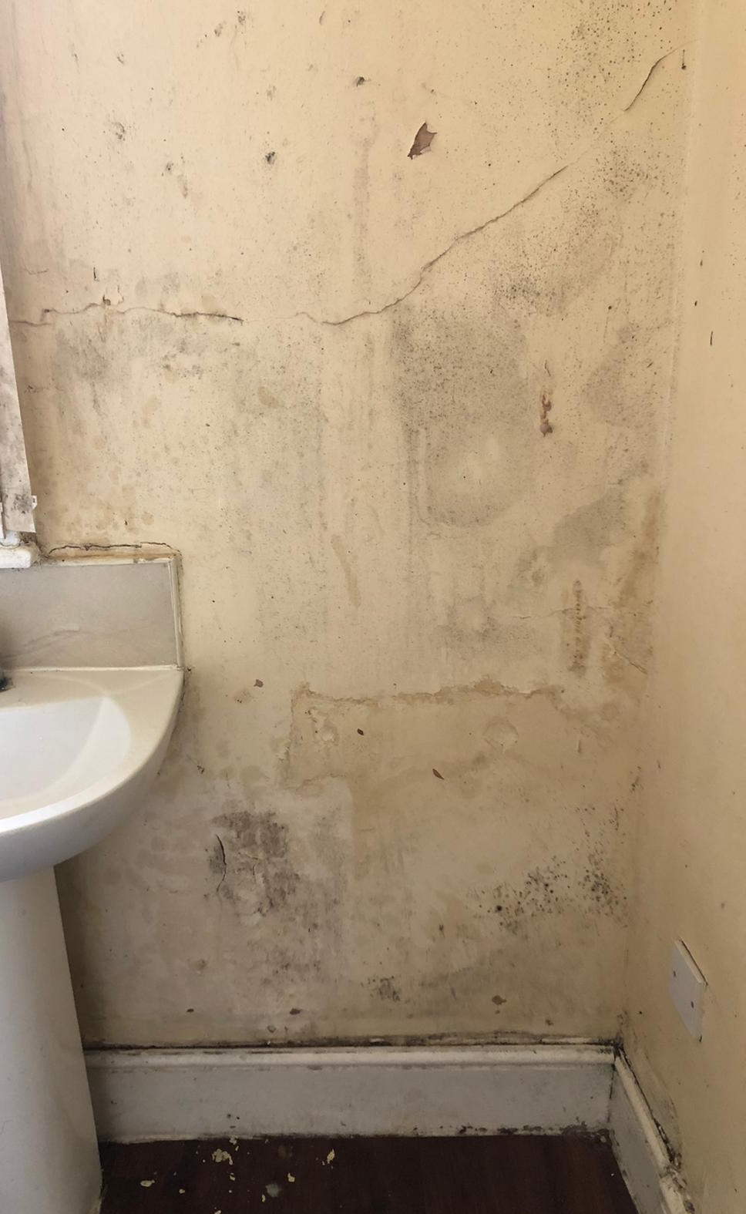
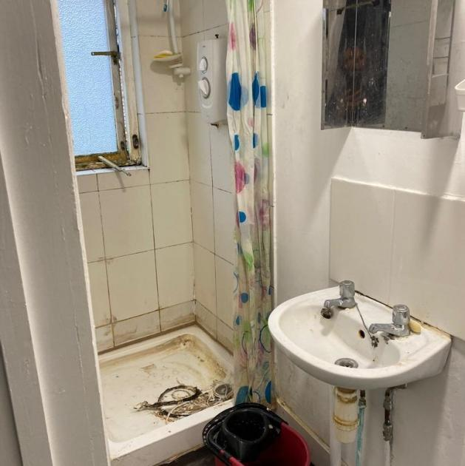
Common issues with Home Office accommodation
Language barrier in applying for accommodation,
Access to information needed on accommodation forms,
Length of time to receive a decision,
Can be placed or moved anywhere in the UK,
Overcrowding in accommodation,
Poor condition of accommodation,
Clashes between differences in people,
Many more!

Slide 10
Questions?

