Slide 1
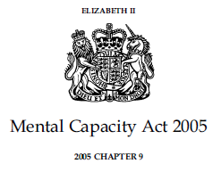
The Mental Capacity Act (and Immigration Removal Centres)

Slide 2
The key question before we begin
Is there a decision to be made by P?
In custodial settings there are relatively few. The state has already intervened to remove autonomy from those it detains
But the less autonomy one has the more important it is to protect the autonomy that remains

Slide 3
Who?
Age: from 16 +
Any: impairment of, or a disturbance in the functioning of, the mind or brain
Conditions include: Dementia, learning disability, brain injury,
mental illness, autism,
confusion,
substance misuse,
unconscious ,
Concussion.
When & Where?
England and Wales
No physical boundary - anywhere
home, hospital,
GP practice, care home, day centre,
dentist, high street,
supported housing
IRCs
Which decisions?
All health, social care & financial decisions
washing, dressing, going out, toileting, nursing care, domiciliary care, housing support, providing accommodation, contact
all medical treatment, diagnostic tests, allied health therapies, emergency care, dental care– and litigation

Slide 4
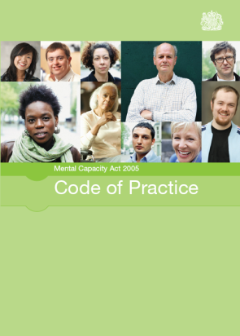
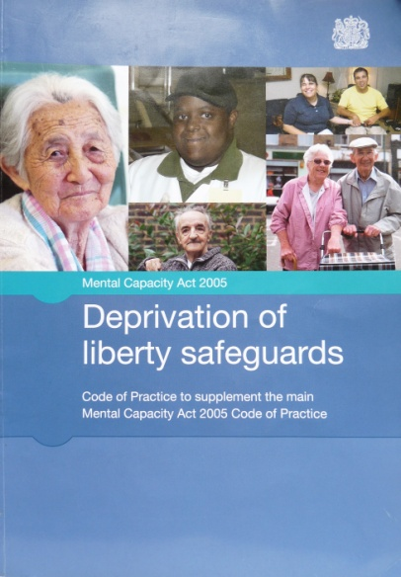
Legal status
primary Legislation
1st
Case Law
2nd
Statutory Codes of Practice
Duty on professionals and paid workers to ‘have regard’ to them.
Rules Policies and procedures
3rd

Slide 5

How do we decide the authority to do something
IF THERE IS NO LEGAL AUTHORITY, TO DO SOMETHING TO SOMEONE, IT IS UNLAWFUL
Consent – may I bath you? May I give you this injection? May I kiss you?
The Detention Centre rules. e.g. use of force
or the Mental Capacity Act.

Slide 6
What is consent?
Consent is the voluntary and continuing permission of a patient to be given a particular treatment, based on a sufficient knowledge of the purpose, nature, likely effects and risks of that treatment, including the likelihood of its success and any alternatives to it. Permission given under any unfair or undue pressure is not consent
MHA COP 23.31

Slide 7
The key areas we will consider
Health Care
Personal Care
Financial matters
Capacity to litigate
But not the use of force in prisons and IRCs, although the MCA is referenced in the Brook House use of force policy

Slide 8
The principles
A person must be assumed to have capacity unless you can prove they lack capacity
You must help people when assessing their capacity – take practicable steps
The Principles
protecting People
(Section 1)
Any care for a person who lacks capacity must be in their best interests
An unwise decision does
NOT
mean a person lacks capacity
Are there
less restrictive ways to give the care?

Slide 9
Assessment of Capacity
Time and Decision specific
Understand + Retain + Use/Weigh + Communicate
Best Interests
If a person lacks capacity nothing can be done to them unless it is in their Best Interests.
Includes: Persons wishes + Consult others + Less Restrictive options + Involving the person
Definition: use or threat of force to make a person do something they resist or restriction of liberty of movement, whether or not the person resists. Criteria: Lack capacity + Best Interests + prevent harm to person lacking capacity + Proportionate
Restraint
Deprivation
of
Liberty
To protect people from coming to harm who need care in hospital/care home.
Professional assessment + legal criteria + extra rights

Slide 10
Assessing capacity 1st steps
Presume the person has capacity and can therefore give consent to treatment/care.
Why are you assessing capacity? – the patient was not able to give informed consent (they are confused, paranoid, delusional etc).
Any judgment a person lacks capacity MUST be ‘BECAUSE OF’ the impairment or disturbance in the functioning of their mind or brain.

Slide 11


Minimising the scope
The assessment of capacity is just a conversation with a person – judging whether they can understand+retain+use or weigh + communicate
Decision specific
What is the decision that needs to be made?
Some people may have capacity to make some decisions but not others.
Time specific
Does a person have capacity to make a decision at a particular moment in time?
People’s capacity to make decisions may change over time.
A drunk person may lack capacity to consent to treatment in A&E at 11pm but 2 hours later may have capacity.
Notes:
11

Slide 12
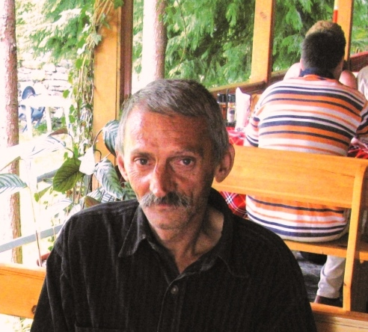

Maximizing Autonomy
1
The less autonomy one has, the more important it is to protect what one is left with.
Let me introduce Mr. Rusi Stanev
Notes:
Rusi Kosev Stanev was diagnosed with schizophrenia in 1975 and declared unfit to work in 1990. In 2000, following a request from his stepmother and half-sister, a court declared him partially legally incapacitated without notifying him. Since his relatives declined guardianship, a municipal council officer was appointed his guardian. Without informing Stanev, the guardian requested that he be placed in a social care home for 'people with mental disorders'. Consequently, in 2002, Stanev was taken to an isolated home about 400 kilometers from his hometown and 80 per cent of his pension was transferred there as payment. Stanev’s identity papers were kept by the staff and, in 2005, the home director was appointed his guardian. He was under constant supervision and only allowed to leave the home with explicit permission. After visiting the social care home in 2003, the European Committee for the Prevention of Torture and Inhuman or Degrading Treatment (CPT) found that the deplorable living conditions and lack of therapeutic activities could be said to amount to inhuman and degrading treatment. Nevertheless, Stanev remained confined there. Although the State had committed to close the home after the CPT visit, renovations were conducted in 2009.
In 2004 and 2005, through his lawyer, Stanev expressed the desire to leave the home permanently and asked the prosecutor and the mayor to bring actions to restore his legal capacity. They both refused based on medical assessments indicating that Stanev had schizophrenia and that the home was the most suitable place for him. His appeals against these decisions were upheld by the appellate prosecutor and various courts. In 2006, at his lawyer’s request, Stanev was examined by independent psychiatrist and psychologist who found that his schizophrenia diagnosis was inaccurate, his residence in the home was damaging his mental health, and he should be reintegrated into society.
In 2012, the Court found that Stanev’s indefinite and involuntary placement by State authorities in a home amounted to deprivation of liberty under Article 5(1) of the European Convention for Human Rights (ECHR), primarily due to the lack of Stanev’s consent as required under partial guardianship laws. Additionally, due to the absence of a recent psychiatric assessment justifying the detention, it did not comply with requirements for “lawful detention . . . of persons of unsound mind.” Further, the Court found violations of Article 5(4) (judicial review of deprivation of liberty) and Article 5(5) (right to compensation) based on Stanev’s inability under Bulgarian law to directly challenge the lawfulness of his detention and to claim compensation. Taking Article 3 (degrading treatment) alone and with Article 13 (effective remedies), the Court also found that the conditions in the home amounted to degrading treatment (at least until the 2009 renovations) and that because Stanev’s residence was not considered detention under domestic law, he was not afforded an effective remedy. Furthermore, the Court found a violation of article 6(1) (access to court) because Stanev lacked standing to directly apply for judicial restoration of his legal capacity. Noting positive developments in Europe and in the international human rights system, the Court indicated that although the right is not absolute, the significance of a declaration of incapacity requires that restrictions on the right of affected individuals to access courts must be limited and proportionate to a legitimate aim.
The Court ordered Bulgaria to pay Stanev 15,000 euros in non-pecuniary damage. It further determined that the State should consult Stanev to ascertain whether he wished to stay in the home and, if not, to reconsider his situation. The Court also recommended that, as a general matter, the State take measures to ensure effective access to court for individuals under partial guardianship seeking restoration of their legal capacity.

Slide 13

Maximizing Autonomy
To summarise
The point of the Mental Capacity
Act is to ensure that every
person has as much autonomy
as is allowed by their mental
abilities, even where they are
limited.
It is NOT just a way to find a legal process to take over the decision-making processes of someone for their own good when they don’t want to accede to your will

Slide 14
Assessment of Capacity [Section 3]
Time and Decision specific
Practicable
steps
Understand information relevant to the decision
Retain the information
only long enough to make the decision
Use/weigh the information as part of the
decision making process*
Communicate the decision
Any form of communication – does not have to be verbal
[Saying ‘No’ is communication!!!]

Slide 15

Understand the relevant information
Nature – what are you going to do/what is
going to happen?
Purpose – why are you going to do it/why
is this needed?
Consequences – the risks or consequences of making the decision (Code of Practice 4.16)
Simple terms and basic language
“What is required here is a broad, general understanding of
the kind that is expected from the population at large.” – referring to proposed surgery to leg.
NOT all detail just salient parts
“..it is not necessary for the person to comprehend every
detail of the issue…” LBL v RYJ [2010] EWHC 2664
A person may say ‘yes’ or ‘no’ to something but not
understand anything about the decision [lack capacity].

Slide 16
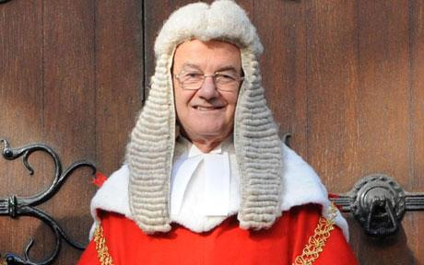
Use or Weigh
Understand information but
not able to use/weigh:
Phobia/fear – the panic or fear induced by a phobia may mean that a person is not able to use or weigh the information required. Needle phobia – pregnancy – caesarian section. [Re: MB (1997)]
Misperception of reality – Ms T – is 37 years old with a Borderline personality disorder – requiring blood transfusion [life threatening]. “I believe my blood is evil, carrying evil around my body. Although the blood given in transfusion is perfectly healthy/clean, once given to it mixes with my own and also becomes evil.”
[T v NHS Trust [2004] EWHC 1279]
Anorexia, Prader Willi Syndrome
Notes:
Key point is that use or weigh is separate to understanding – this is deliberate. The courts have come across a number of cases where people could understand but not separately ‘use or weigh’. The cases are all linked to mental health issues so it is important to be able to identify them.

Slide 17

Balance of probabilities
The person assessing capacity
only has to have a ‘reasonable
belief’ the person does/does
not have capacity. Protection
for those assessing capacity.
Who can make the assessment?
Anyone Person with authority
– job spec!
How often to assess capacity?
A judgment has to be made depending
on how much the person’s capacity
fluctuates
Notes:
Implied consent is animated – you give an example – person coming for injection (depot) or tablets who probably has capacity issues. Because they have come to you and presented for medication/depot is this consent?

Slide 18
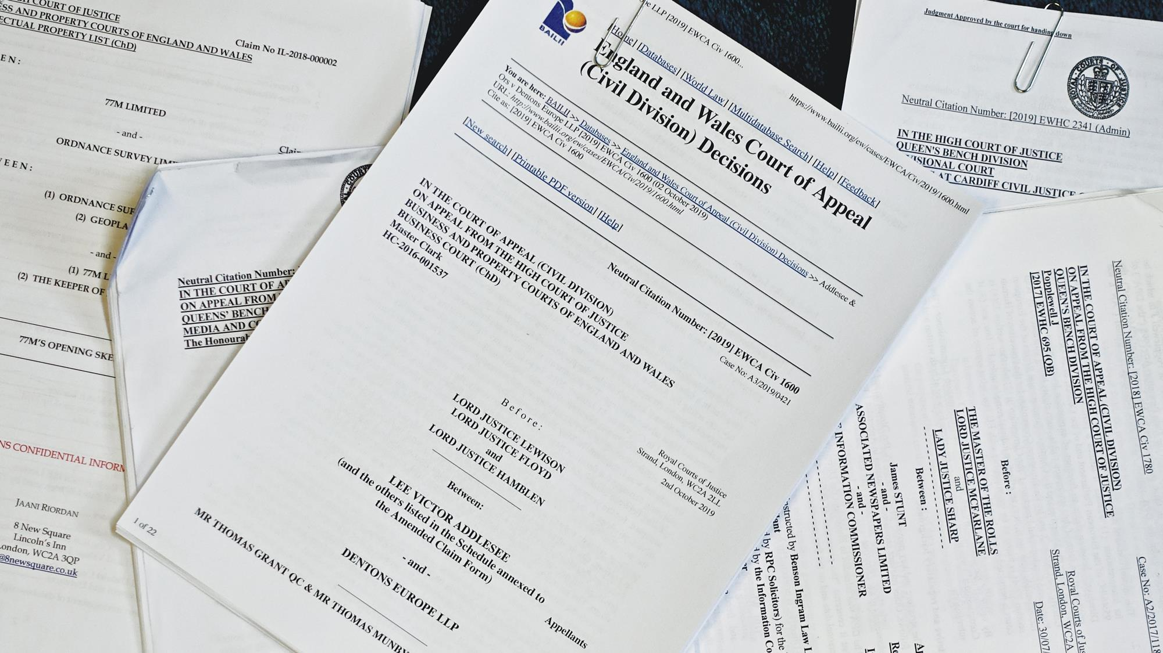
Unwise v. Incapacitated
2
Re C (Adult: Refusal of Treatment) [1994] 1 WLR 290 at 295 (Broadmoor leg amputation)
North Bristol NHS Trust v R [2023] EWCOP 5
Locked door on elderly care ward
Blood transfusion and the Jehovah’s witnesses (Nottinghamshire Healthcare NHS Trust v RC)
Notes:
A patient, who understands the nature, purpose and effects of proposed medical treatment, has the capacity to refuse that treatment, even if his general capacity is impaired by chronic mental illness. The High Court has jurisdiction to grant injunctive relief relating to future medical treatment. Mr Justice Thorpe granted an injunction preventing Heatherwood Hospital, Ascot, from giving C an amputation now or in the future without C's express written consent. C, now aged 68, was serving a seven-year prison sentence in 1963 when he was diagnosed as mentally ill and transferred to Broadmoor. In September 1993, he was diagnosed with gangrene in the right foot and it was considered C would die if the leg was not amputated below the knee and that C's chances of survival with conservative treatment would be no better than 15 per cent. C refused to consider amputation. C consented to more conservative treatment which was successful and the 85 per cent chance of imminent death predicted was averted. The hospital refused to give an undertaking that it would not amputate in any future circumstances. C sought an injunction to restrain the hospital from amputating his right leg without his express written consent. Medical evidence was given that the condition of C's foot would again threaten C's life and that a below-knee amputation carried a 15 per cent mortality risk. C gave evidence expressing his rooted objection to amputation. Richard Gordon and Craig Barlow (Scott-Moncrieff & Harbour, Brighton) for C; Peter Jackson (Official Solicitor) for the Official Solicitor; Adrian Hopkins (J Tickle & Co) for the hospital.
MR JUSTICE THORPE said that C was quite content to follow medical advice and to co-operate in treatment as long as his rejection of amputation was respected. C's rejection of amputation seemed to result from sincerely held conviction.
When considering the capacity that enabled an individual to refuse treatment, the question to be decided here was whether it had been established C's capacity was so reduced by his chronic mental illness that he did not sufficiently understand the nature, purpose and effects of the proposed amputation. The decision-making process could be analysed into three stages - first, comprehending and retaining the treatment information; second, believing it; and third, weighing the information, balancing risks and needs, to arrive at a choice. Applying that test, the presumption that C had the right of self-determination had not been displaced. Although his general capacity was impaired by schizophrenia, it had not been established that he did not sufficiently understand the nature, purpose and effects of the treatment he refused. He had understood and had arrived at a clear choice.
A detained patient (RC) was self-harming by cutting and had made an advance decision refusing blood transfusions. (1) RC had capacity to refuse blood transfusions and sometimes had capacity to lacerate himself. (2) The advance decision was valid and applicable. (3) The self-harming was a symptom or manifestation of mental disorder so a blood transfusion would be treatment under s63 MHA 1983. (4) Where the consequences of a decision not to impose s63 treatment may be life-threatening the Trust should apply to the High Court for declaratory relief and (just as with a decision to impose treatment) the hearing will involve a 'full merits review'. (5) It would be lawful to withhold blood transfusions despite the s63 power (indeed, the judge stated that given RC's current capacity and advance decision it would be 'an abuse of power ... even to think about imposing a blood transfusion' and that it 'would be a denial of a most basic freedom’).
A professionals meeting concluded that she: ‘...did not present with a major mental illness, that trauma was likely part of her presentation and that R tended to present with a learning difficulty rather than a learning disability.’
The judge finds she does lack mental capacity to the decision and authorises the caesarean section in her best interests. A healthy baby boy is delivered.

Slide 19
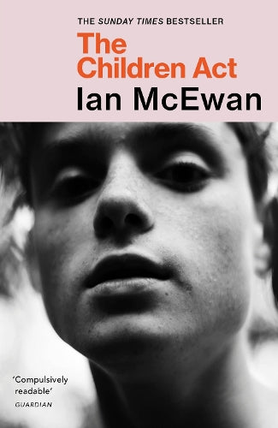
A good read (or film)

Slide 20

Food Refusal in IRCs
You have to have the mental capacity to refuse food
21. Before a healthcare practitioner provides medical treatment for a detained individual who is refusing food and/or fluid, they must ensure that they have the detained individual’s consent to do so. Mental capacity in respect of medical treatment, which must be reviewed on a daily basis, will be
established by the treating healthcare
professional.
24. Detained individuals with mental capacity
to take a particular decision are entitled to
refuse treatment being offered, even if this
will clearly be detrimental to their health.
Administering medical treatment to a person
with full mental capacity, or forcing them to
take food and/or fluid against their will, in
the absence of consent may amount to
common assault.

Slide 21
Recording an assessment
Decision-makers should ensure that where a capacity assessment is undertaken, this is recorded in the individual’s care and treatment record. ..the following should be recorded:
the specific decision for which capacity was assessed
the salient points that the individual needs to understand and comprehend and the information that was presented to the individual in relation to the decision
the steps taken to promote the individual’s ability to decide themselves. How the information was given in the most effective way to communicate with the individual
how the diagnostic test was assessed, and how the assessor reached their conclusions,
how the functional test was undertaken, and how the assessor reached their conclusions. (Para 13.22)

Slide 22
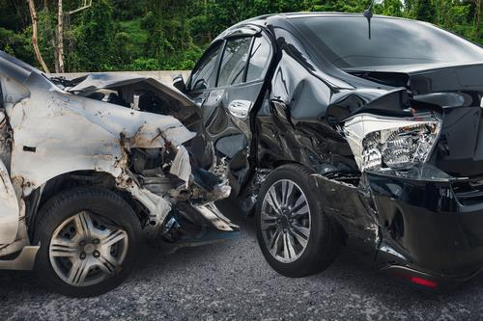
What do you think of this?
This is a direct screen dump from a court report on a young person who stole their mother’s car and drove it into oncoming traffic causing serious injuries to the occupants of the oncoming car. They were suffering from chronic schizophrenia and had a long history of impulsive self destructive acts. The author is a consultant forensic psychiatrist and a professor.

Slide 23
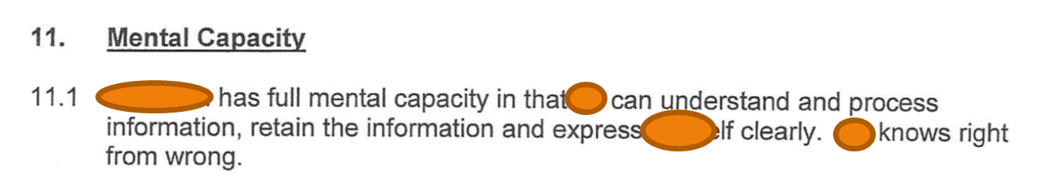
What is wrong with the previous example?
What information can P process (weigh and use?
Knowing right from wrong is not relevant to the MCA assessment

Slide 24
Best interests (section 4)
The assessment of capacity has no power! It is just a statement – the power/authority to treat/care through a Best Interests assessment.
Power to: give care, stop existing care or withhold care to a person that lacks capacity (technically a defence)
The person making the best interest assessment needs to show an impartial and objective approach – a balance sheet.
It is a procedural statutory checklist – all points must be considered as a minimum.
Code of Practice [Para 5.15] “Any staff involved in the care of a person who lacks capacity should make sure a record is kept of the process of working out the best interests of that person.”

Slide 25
Best interests checklist
All relevant circumstances
The person’s reasonably ascertainable past and present wishes/statements + their beliefs and values + any other factors they would take into account
Consult others as practicable and appropriate to do so. Examples: carers, relatives, attorneys, deputies,
Consider less restrictive options - can the same result be achieved in a less restrictive way? [Principle]
Will the person have capacity sometime in the future in relation to the matter? If so, when?
Must encourage and permit the person to participate
Don’t base the ‘best interests’ decision solely on age, appearance, behaviour or condition
If the decision is about life-sustaining treatment, do not be motivated by a desire to bring about the person’s death.

Slide 26
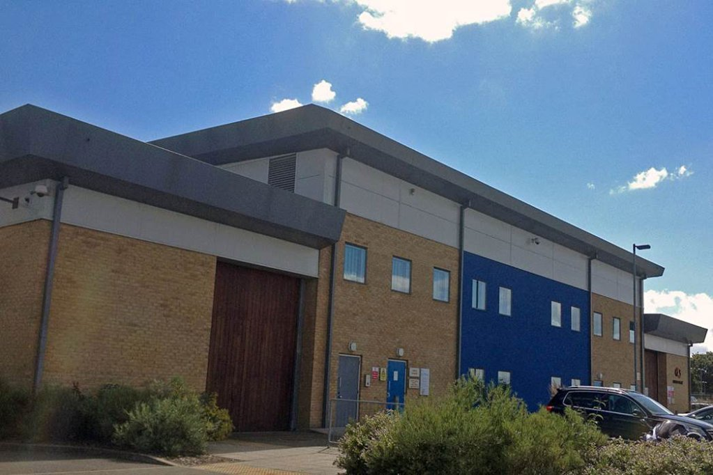
More specifically

Slide 27
Terminology in criminal justice
Having a mental impairment affecting P’s ability to carry out day to day activities
Having a mental health problem
Lacking decision making capacity
Vulnerable
At Risk

Slide 28
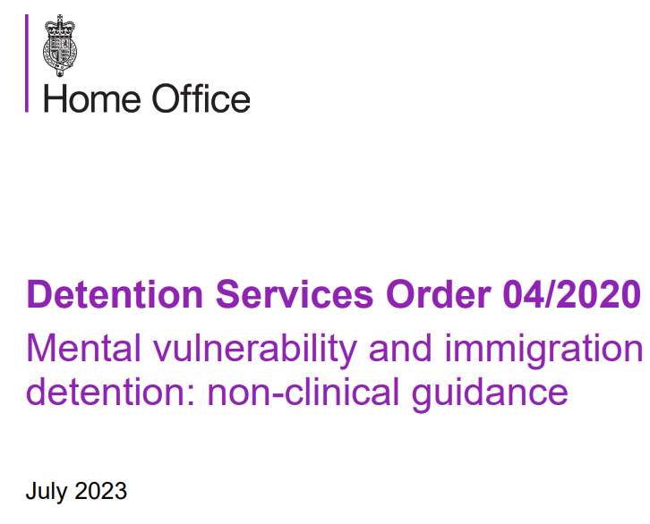
The Home Office official view
Guidance on adults at risk in immigration detention – ‘at risk’ is not the same as incapacitated
Detention services order 04/2020: mental vulnerability and immigration detention
‘14. The principles of the UK Mental Capacity
legislation apply to all persons, including
those in immigration detention. These
include the principle that individuals
should be assumed to possess capacity
unless it is established otherwise on
the balance of probabilities.’

Slide 29
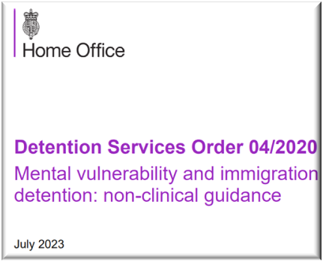
What is required
33.Each IRC must keep records of the numbers of people referred for an assessment of capacity, along with the outcome of that assessment.
Let’s find out more
4.All onsite Home Office and Contractor IRC staff should receive training on identifying, support and management of individuals
in detention who have mental
health conditions, including
mental incapacity.
Really!!!!

Slide 30
Practical steps for the IRC
22.In cases in which the individual may lack capacity in respect of a particular decision, the member of staff who has identified the possible lack of capacity should take any necessary steps to ensure that the individual has access to legal representation and that any necessary reasonable adjustments are made to accommodate this or to facilitate any daily living issues experienced by the individuals.
Where appropriate, this
consideration should be carried
out with the support of
healthcare and other members
of staff

Slide 31


But ……..
3
Let me introduce you to WHH:
Judicial Review December 2023
Notes:
WHH is a Sudanese asylum claimant who arrived in the United Kingdom in 2019 as an unaccompanied minor. He has been diagnosed with autism spectrum disorder, mild learning disability, anxiety and depression as well likely schizophrenia and possible post-traumatic stress disorder. WHH was detained from 16 June 2021 to 30 November 2022, when he was released on High Court bail following a successful application for interim relief. As a result of his mental impairments, WWH lacks, and is likely to have lacked throughout the period of his detention, mental capacity to make immigration related decisions, including mental capacity to decide to cooperate with attempts to remove him to Sudan.

Slide 32
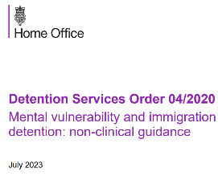
But ……..
the Home Office conceded that Detention Services Order 04/2020: Mental Vulnerability and Immigration Detention (“the DSO”) is not operating ‘effectively or as intended in certain cases, in particular, in cases where concerns are raised about a detained individual’s ability to make immigration related decisions’.
1. It was in breach of the Defendant’s Adults at Risk in Immigration Detention Guidance (“the AAR Policy”)
2. It was inconsistent with the Hardial Singh principles, particularly in circumstances where the Defendant had failed to comply with his own Detention Case Progression Panels Policy
3… the Defendant did not make adequate arrangements to treat WHH differently from a detained individual without a learning disability, in particular by failing …… to assess WHH’s mental capacity to make decisions relevant to his immigration position and detention
The Defendant indirectly discriminated against WHH, contrary to s.19 of the - Equality Act 2010, by failing to screen those detained
- under immigration powers for learning disabilities.
The Secretary of State must intend to deport the person and can only use the power to detain for that purpose;
The deportee may only be detained for a period that is reasonable in all the circumstances;
If, before the expiry of the reasonable period, it becomes apparent that the Secretary of State will not be able to effect deportation within that reasonable period, he should not seek to exercise the power of detention;
The Secretary of State should act with reasonable diligence and expedition.

Slide 33

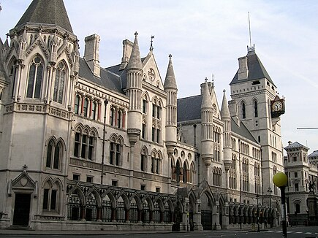
Off to the High court ….
4
The HO acknowledged:
There is no mechanism to identify those without capacity to make decisions relevant to their detention
They did not screen for learning disabilities
The mental vulnerability log is not operational
The Home Office central record of mental capacity assessments is not operational
Notes:
It is shocking that WHH was detained for 18 months due to the Home Office’s disregard for vulnerable detainees and the failure to implement policies designed to care for them.
During the course of his detention, there was no mechanism in place that would have allowed for WHH’s learning disability or capacity to be assessed. He did not understand how to take steps to secure legal advice or apply for release from detention. He did not understand the documents given to him by the Home Office or how to engage with the system.
Understandably this has resulted in significant damage to WHH’s mental health, and he remains extremely unwell. We hope that he is granted permission to stay in the United Kingdom and he is given the opportunity to rebuild his life.
It is shocking that WHH was detained for 18 months due to the Home Office’s disregard for vulnerable detainees and the failure to implement policies designed to care for them.
During the course of his detention, there was no mechanism in place that would have allowed for WHH’s learning disability or capacity to be assessed. He did not understand how to take steps to secure legal advice or apply for release from detention. He did not understand the documents given to him by the Home Office or how to engage with the system.
Understandably this has resulted in significant damage to WHH’s mental health, and he remains extremely unwell. We hope that he is granted permission to stay in the United Kingdom and he is given the opportunity to rebuild his life.

Slide 34
Litigation capacity or fitness to be interviewed
Is there a decision for P to make?
Yes – Litigation Capacity
No - Fitness for interview

Slide 35
Fitness for interview 1
‘A detainee may be at risk in an interview if:
(a)conducting the interview could significantly harm the detainee's physical or mental state;
(b)anything the detainee says in interview about their involvement or suspected involvement in the offence about which they are being interviewed might be considered unreliable in subsequent court proceedings because of their physical or mental state.’
(Police and Criminal Evidence Act 1984 (PACE): Code C, Annex G)

Slide 36
Fitness for interview 2
Mental disorder and mental vulnerability
Code C now addresses not just mental disorder, for which it adopts the definition of mental disorder in section 1 of the Mental Health Act 1983, but also ‘mental vulnerability’, which applies to anyone who ‘because of their mental state or capacity, may not understand the significance of what is said, of questions or of their replies’ (Code C, guidance note 1G).

Slide 37
Fitness for interview 3
Interview induces a psychosis
Prone to fantasise
Emotional distress or arousal boasting and exaggeration – in Low IQ
Under the influence
A childlike desire to protect
Abnormally suggestible and compliant
Prolonged questioning

Slide 38

The Asylum Interview
5
The interviewer can allow a supporter
But they must be careful
Nothing about capacity
or vulnerability. Nothing
about litigation friends,
Nothing about practical steps
Notes:
Exceptionally, however, and with advance notice, you may allow a friend or other companion of the claimant to be present to provide emotional or medical support. For example, if an interviewer of the requested gender has not been possible. Alternatively, a claimant may benefit from the presence of a supporter from their faith group or non-religious organisation before or during the interview, and this can also be accommodated exceptionally and where advance notice is provided.
However, you must keep in mind the need to safeguard against the possibility that a trafficker or smuggler may use this as an opportunity to influence or monitor the claimant’s asylum claim. You must therefore first establish with the claimant alone whether they are content for the friend, companion or supporter to be present during the interview. The interviewer must also consider whether the claimant might be under the control of a trafficker. If it is a known or suspected trafficking case, the identity of the friend, companion or supporter should be carefully considered.

Slide 39

Acting as a supporter in an asylum interview
‘For reasons of confidentiality, you will normally interview a claimant on their own or in the presence of a legal representative or regulated adviser. Exceptionally, however, and with advance notice, you may allow a friend or other companion of the claimant to be present to provide emotional or medical support. For example, if an interviewer of the requested gender has not been possible. Alternatively, a claimant may benefit from the presence of a supporter from their faith group or non-religious organisation before or during the interview, and this can also be accommodated exceptionally and where advance notice is provided.
A friend, companion or supporter must NOT be permitted to attend if they: are a FAMILY MEMBER are SEEKING ASYLUM SEPARATELY themselves, have any OBVIOUS PERSONAL INTEREST in the outcome of the claim, have ENGAGED IN PROVIDING LEGAL ADVICE to the claimant
Whilst it is important to keep the presence of a friend, companion or supporter to a minimum, you must discuss any request from the claimant with a Senior Caseworker and accommodate this if there are exceptional circumstances which would mean that this is appropriate.
A friend, companion or supporter can be admitted on condition that
they are there solely to provide emotional, medical or spiritual
support. They must not intervene during the interview unless it is to
raise a welfare or safeguarding concern with the claimant, using the
Home Office interpreter’

Slide 40

Capacity to litigate
the test to be applied, as it seems to me, is whether the party to legal proceedings is capable of understanding, with the assistance of such proper explanation from legal advisers and experts in other disciplines as the case may require, the issues on which his consent or decision is likely to be necessary in the course of those proceedings’
Case of Masterman-Lister (2002), Point 75

Slide 41

Litigation friends in Immigration Tribunals
In the case AM (Afghanistan) [2017] EWCA Civ 1123 the Court of Appeal accepted that the common law duty of fairness and natural justice required this, finding “there is ample flexibility in the tribunal rules to permit a tribunal to appoint a litigation friend in the rare circumstance that the child or incapacitated adult would not be able to represent him/herself and obtain effective access
to justice without such a step being
taken. In the alternative, even if the
tribunal rules are not broad enough
to confer that power, the overriding
objective in the context of natural
justice requires the same
conclusion to be reached.”

Slide 42
So what does a litigation friend do?
You must 'direct the proceedings' on behalf of the other person if you're their litigation friend. This means you'll make decisions in their best interests. do everything you can to tell them what's happening in the case and find out their wishes and feelings.
You are not their lawyer. You are in effect their voice and instructing their lawyer if they have one

Slide 43
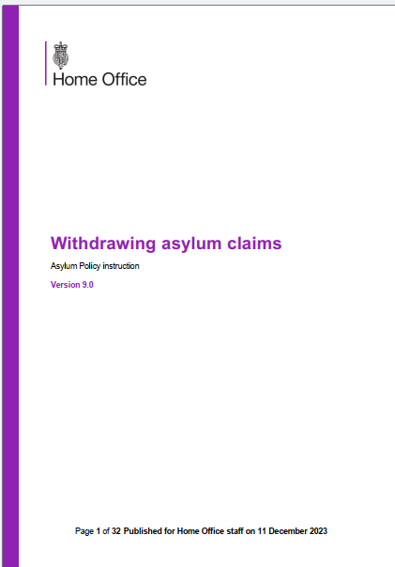
Capacity to withdraw an asylum claim
When considering the withdrawal of an asylum claim, you must take reasonable steps to ensure you are satisfied that the claimant holds the mental capacity to make an informed decision to withdraw their claim.
In all cases, you must conduct a detailed check on the Case Information Database (CID) or Atlas or other relevant Home Office IT systems to identify any concerns which may highlight that the claimant lacks mental
capacity and check whether any previous
safeguarding referrals have been made.
Additionally, if the claimant does not
have legal representation, then you must
also review any documentary evidence on
file to determine whether there is any
additional evidence to suggest the claimant
may lack mental capacity.

Slide 44

If there are no decisions to be made yet
So who is the decision maker?
There isn’t one yet so
Ask the LA to make a safeguarding referral and then either they or we can go to the Court of Protection applying for an appointeeship

Slide 45


migrants capacity specialists
8
http://tinyurl.com/3rfhseyr
http://tinyurl.com/yeykm8um
Notes:
We then successfully obtained a welfare order from the Court of Protection to allow the independent advocate to make immigration decisions and instruct a solicitor on EM's behalf
The judge hearing the appeal of EK’s deportation order indicated that a litigation friend was merited and one of the MMCA Project’s trained litigation friends was appointed to act on his behalf. In EK’s case, the appointment of a litigation friend also proved to be a crucial step in winning his appeal and regularising his status. Prior to the LF’s appointment, EK’s immigration representatives had struggled to take instructions from him due to his mental health issues. Additionally, EK’s imprisonment had made it difficult for them to communicate with EK. As in EM’s case, appointing a litigation friend who could take decisions in EK’s best interests and instruct his solicitors enabled the appeal of his deportation order to move forward in a timely manner.

